Slide 1
Platform for Visualizing Life Cycle Assessment and Tracking of Consumer Products
Daniel Bischoff
Steffen Herrdum
Lin Xu

Slide 2
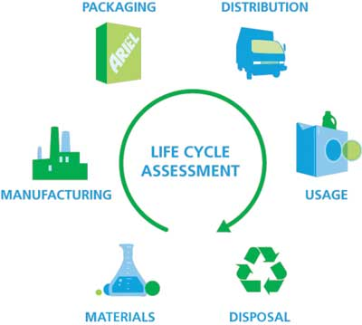
What is LCA?

Slide 3

What are we doing?

Slide 4
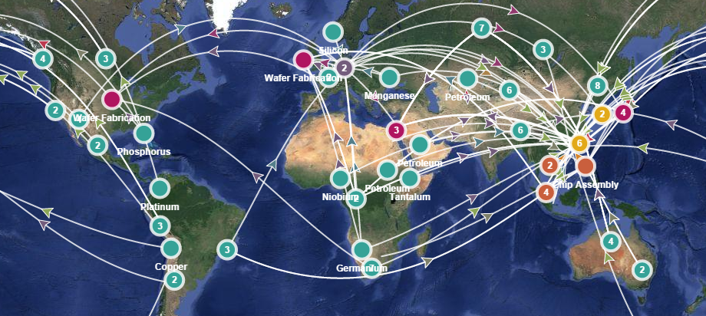
Use Case

Slide 5





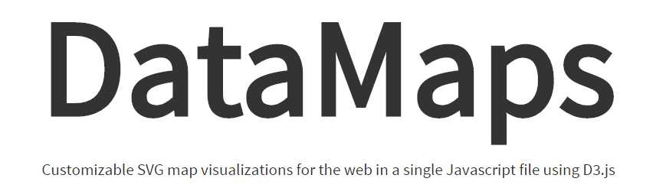

Technology

Slide 6
Limitations
Only fictional data
Limited spectrum of products

